Slide 1

Modern Mobile Development
Kevin E Ford
Mobile Practice Lead,
Magenic
Level: Intermediate

Slide 2
Development Options
Mobile Enabled Web
Hybrid
True
Native
Near Native
HTML5/JS
Cordova
Xamarin
Java-Android
Objective-C /iOS
Notes:
Generally the closer to native you get the better the potential user experience
Tools like Xamarin use native UI technologies and generally offer day one support for most new features
However, many tools are made for “true” native technologies, such as tools that wrap apks may work better with true native technologies
True native technologies represent the OS creator’s preferred way of writing applications for the OS
True native tools are free

Slide 3




Application Architecture
HTML 5 UI
iOS UI
Windows Universal
Android UI
JavaScript BL
BL
BL
BL
Service Proxy
Data Portal
Data Portal
Data Portal
Reports
SQL Reporting
REST API
Data Portal
ASP.NET WA
BL
Excel
DAL
PowerPivot
SQL Database
Blobs
Notes:
Mostly concerned with orange layer
Share presentation, VM and M
VM and M also shared with UWP app
This is possible because we use an MVVM framework that allows us to span these different platforms

Slide 4
Layers Represent Decision Points
Interface
Interface Logic
Business Logic
Data Access
Data
Notes:
Layers give opportunity for code sharing
Closer to the interface and platform SDK you get, the less opportunity there is for sharing.

Slide 5
Framework Capability Overlap
 | Xamarin Forms | MVVMCross | CSLA
Full UI coding
UI Binding
MVVM Structure
IoC Container / DI
UI /Component Abstractions (Navigation)
Global Messaging
Business/Validation/Authorization Logic
Server/Client Logic Sharing

Slide 6
The Mvvm Pattern
View
Xamarin Forms – Layouts and data binding
ViewModel
MVVMCross – ViewModels and navigation
Model
CSLA – Models and business logic

Slide 7
Typical Project Structure
Android Project
Android XML
Shared with server
Activities / Fragments
Platform Value Converters
Common PCL
Core PCL
Platform Services
Models
View Models
UWP Project
Common Interfaces
Data Access Services
XAML
Authorization logic
Shared Value Converters
XAML Code Behind
Validation logic
Models
Platform Value Converters
Common Interfaces
Platform Services
iOS Project
Authorization logic
Xibs / Storyboards / Views
Validation logic
View Controllers
Platform Value Converters
Platform Services

Slide 8
Application Lifecycle
SplashScreen : MvxSplashScreenActivity
App : Application
AppDelegate : MvxApplicationDelegate
Setup : MvxAndroidSetup
Setup :
MvxWindowsSetup
Setup : MvxIosSetup
App : MvxApplication
ViewsContainer : MvxIosViewsContainer
LoginActivity : MvxAppCompatActivity
LoginPage :
MvxWindowsPage
LoginViewController: MvxViewController
LoginViewModel : MvxViewModel

Slide 9
MvxApplication
Shared App initialization
Must inherit from MvxApplication
Identify first view model of application
Shared app registration
public class App : MvxApplication { public override void Initialize() { base.Initialize();
Mvx.RegisterType<ICustomerService, CustomerService>(); RegisterAppStart<CustomerListViewModel>(); } }
Identify application’s first view model

Slide 10
Creating the View Model
Construction
Init
Reload State
For OSes that support tombstoning
Start
Save State

Slide 11
Construction
Usually just used to receive dependency injected references
Mvx.RegisterType<ICustomerService, CustomerService>();
Mvx.RegisterSingleton<ICustomerService>(new CustomerService());
New instance every time
Use single instance every time
Needs to Resolve ICustomerService
Resolves CustomerService due to registration
public CustomerListViewModel(ICustomerService customerService) { _customerService = customerService; }

Slide 12
Init – Passing parameters (part 1)
Init method designed for view model to receive parameters from sender
Pass array of values
ShowViewModel(typeof(EditCustomerViewModel), new { customerId = ”123” });
In this style parameter names / types must match – tied by convention
public void Init(string customerId) { }
Can send values or simple serializable objects, nothing passed by reference

Slide 13
Init – Passing parameters (part 2)
Other option involves sending MvxBundle object
var bundle = new MvxBundle(); bundle.Write(new Dictionary<string, string>() { { "customerId", "1234" }}); ShowViewModel<EditCustomerViewModel>(bundle);
Bundle serialized sent to new view model and unserialized
protected override void InitFromBundle(IMvxBundle parameters) { string custId; parameters.Data.TryGetValue("customerId", out custId); }

Slide 14
The Start method
Last of the lifecycle methods to be called in creating / restoring a view model
Normally used for loading of information from local / remote storage
Method uses async / await but is not a Task returning method
_customerId sent as a parameter to the Init method
Can be made async, but will not itself be awaited
_customerService injected in the constructor
public async override void Start() { base.Start(); if (_customerId == Guid.Empty) { Customer = await _customerService.CreateNewCustomerAsync();
} else { Customer = await _customerService.GetCustomerByIdAsync(_customerId);
}
}

Slide 15
Demo – Setting up MVVMCross

Slide 16
Xamarin’s Unique Approach
iOS C# UI
Android C# UI
Windows C# UI
Azure
Linux/Mono
CoreCLR
Shared C# Mobile
C# Server
Shared C# Client/Server
Shared C# codebase • 100% native API access • High performance
Notes:
With Xamarin it just isn’t your front end in C# it is your full backend server as well. With Azure or even on Linux running Mono or the CoreCLR your app is fully C# end to end!

Slide 17



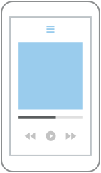
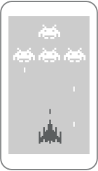

Which Xamarin approach is best for your app?
Xamarin.Forms is best for:
Xamarin.iOS / Xamarin.Android is best for:
Data entry apps
Prototypes and proofs-of-concept
Apps that require little platform-specific functionality
Apps where code sharing is more important than custom UI
Apps that require specialized interaction
Apps with highly polished design
Apps that use many platform-specific APIs
Apps where custom UI is more important than code sharing
Learn more: xamarin.com/forms
Learn more: xamarin.com/platform
Notes:
Pick what is right for you!
Xamarin has this nifty guide to help you decide to go traditional or with Xamarin.Forms

Slide 18
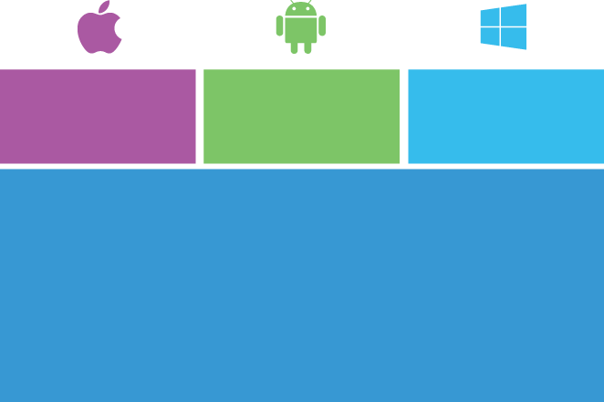

Moving from Xamarin Platform to Forms
iOS C# UI
Android C# UI
Windows C# UI
Xamarin.Forms
Shared App Logic
Shared App Logic
Xamarin.Android / Xamarin.iOS
Xamarin.Forms

Slide 19

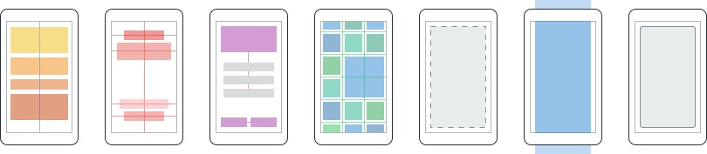
Layouts
Pages
Content
MasterDetail
Navigation
Tabbed
Carousel
Stack
Absolute
Relative
Grid
ContentView
ScrollView
Frame
Notes:
First you have a set of pages for each screen of your application
There are things like Content, and MasterDetail which gives you a nice flyout
With a tabbed view you get the correct look on each platform
iOS on bottom, Android on top, and on WP you have a Pivot control
Inside of a page are layouts
A lot of options from something simple like a stack panel to complex and powerful grids

Slide 20
Forms Project Structure
Android Project
Renderers / Effects
Platform Services
Core PCL
View Models
UWP Project
Data Access Services
Renderers / Effects
Shared Value Converters
Platform Services
Models
Common Interfaces
Authorization logic
Validation logic
Custom Views
iOS Project
XAML
Renderers / Effects
Platform Services

Slide 21
Some Extra Things to Think About with Xamarin Forms
Items not easily controllable in a shared way
Platform specific styling
Material Design
Features that may only exist on one platform
ForceTouch
Amount of platform specific code
ActionBar / SupportActionBar Coloring
Stability

Slide 22
MVVMCross and Xamarin Forms
MVVMCross 4 offers special Library for Forms
Resolution of what page to load by convention
LoginViewModel tries to load LoginPage.xaml
Android has MvxFormsDroidPagePresenter
iOS uses MvxFormsIosPagePresenter
Expects app to use a NavigationPage
As always, can replace out default implementations

Slide 23
Key Entities
MvxFormsApp
MvxPresentationHint
FormsApplicationActivity
MvxFormsDroidPagePresenter
MvxFormsIosPagePresenter

Slide 24
Application Lifecycle
SplashScreen : MvxSplashScreenActivity
App : Application
AppDelegate : MvxApplicationDelegate
Setup : MvxAndroidSetup
Setup :
MvxWindowsSetup
Setup : MvxIosSetup
App : MvxApplication
ViewPresenter : MvxFormsDroidPagePresenter
ViewPresenter : MvxFormsIosPagePresenter
LoginActivity : FormsApplicationActivity
LoginPage :
MvxWindowsPage
LoginViewController: MvxViewController
LoginViewModel : MvxViewModel

Slide 25
Xamarin Forms Binding
<Entry Text="{Binding Password, Mode=TwoWay, Converter=PasswordConverter, ConverterParameter=23, Path=PathToBinding, Source='DifferentSource', StringFormat='formatstring'}" IsPassword="True" Grid.Column="0" Grid.Row="4" HorizontalOptions="FillAndExpand" />

Slide 26
Creating a Value Converter
public class DateConverter : IValueConverter
{
public object Convert(object value, Type targetType, object parameter, CultureInfo culture)
{
var inputValue = value as DateTime?;
if (inputValue.HasValue)
{
return inputValue.Value.ToShortDateString();
}
return value;
}
public object ConvertBack(object value, Type targetType, object parameter, CultureInfo culture)
{
throw new NotImplementedException();
}
}

Slide 27
Demo – Using Forms with MVVMCross

Slide 28
Ways To Customize / Platform
Custom Renderers – (XF 1.0) Complete control over view to native rendering
Effects – (XF 2.1) – Per platform changes on properties
Bindable Native Views (XF 2.3.3) Directly create and add native views
Platform Specifics (XF 2.3.3) Add pre-defined platform specific behaviors

Slide 29
Custom Renderers
Forms
View
iOS
Android
UWP

Slide 30
Demo – Creating a Custom Renderer

Slide 31
Adding in Material Design
Some but not all components easily usable
Can use AppCompat themes
Custom Toolbar (toolbar.axml) / Tabs (tabs.axml)
Themes Change whole App
Need to use Forms AppCompatActivity

Slide 32
Demo – Adding Material Design Styles

Slide 33
Bindable Native Views
Can add native controls directly to layouts
Can include directly in Xaml
If used in XAML, cannot use x:Name
May need special handling for PCLs (Xaml OK)
Don’t always display correctly

Slide 34
Creating a Native View
Xamarin Forms : Layout
Xamarin Forms : NativeViewWrapper
Android : FloatingActionButton

Slide 35
Bindable Native Views in Code
#if __ANDROID__ var actionButton = new FloatingActionButton(Forms.Context); actionButton.SetImageResource(XamarinMALDemo.Droid.Resource.Drawable.ic_add_white_24dp); actionButton.Click += fab_click; var actionButtonView = (NativeViewWrapper)actionButton.ToView(); actionButtonView.HorizontalOptions = LayoutOptions.End; actionButtonView.VerticalOptions = LayoutOptions.End; actionButtonView.Margin = 16; mainLayout.Children.Add(actionButtonView); #else ToolbarItems.Add(new ToolbarItem("Add", "Add", () => {})); #endif

Slide 36
Demo – Bindable Native Views

Slide 37
Links
Sample Code: https://github.com/Bowman74/VSLiveXamarinModernApps

Slide 38
Thank you!
Kevin Ford
Twitter: @Bowman74
kevinf@magenic.com
http://windingroadway.blogspot.com

